Slide 1


JAVA INTERVIEW BOOTCAMP ADVANCE CONCEPTS
Lecture 19
Advance Concepts In Exception Handling

Slide 2
CHAPTER 19
Advance Concepts
Topics Covered
The Error class
Java’s New Exception Handling Features

Slide 3
Errors
An error is a serious exception thrown by the JVM as a result of an error in the environment state that processes your code.
For example, NoClassDefFoundError
which is an error thrown by the JVM when it’s unable to locate the .class file that it’s supposed to run.
Another error is StackOverflowError
which occurs when the size of the memory required by the stack of a Java program is greater than what the JRE has offered for the Java application, for example an infinite recursive code.

Slide 4
Errors
An error is a subclass of class java.lang.Error.
An error need not be a part of a method signature.
An error can be caught by an exception handler, but it shouldn’t be.

Slide 5
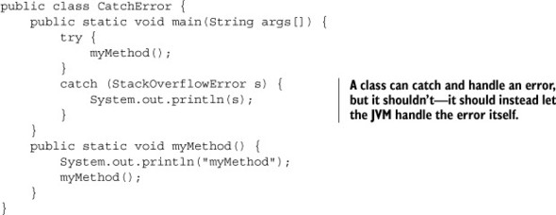
Write A Code that handles StackOverFlowError

Slide 6
Common Exceptions and Errors
Exception | Error
ArrayIndexOutOfBoundsException | ExceptionInInitializerError
IndexOutOfBoundsException | StackOverflowError
ClassCastException | NoClassDefFoundError
IllegalArgumentException | OutOfMemoryError
IllegalStateException
NullPointerException
NumberFormatException

Slide 7
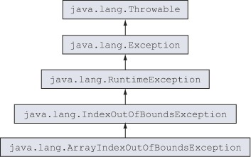
ArrayIndexOutOfBoundsException and IndexOutOfBoundsException

Slide 8
ArrayIndexOutOfBoundsException and IndexOutOfBoundsException
ArrayIndexOutOfBoundsException is thrown when a piece of code tries to access an array out of its bounds (either an array is accessed at a position less than 0 or at a position greater than or equal to its length).
IndexOutOfBoundsException is thrown when a piece of code tries to access a list, like an ArrayList, using an illegal index.

Slide 9
ArrayIndexOutOfBoundsException and IndexOutOfBoundsException
Assuming that an array and list have been defined as
follows:
String[] season = {"Spring", "Summer"};
ArrayList<String> exams = new ArrayList<>();
exams.add(“Java");
exams.add(“Oracle");

Slide 10
ArrayIndexOutOfBoundsException and IndexOutOfBoundsException
The following lines of code will
throw ArrayIndexOutOfBoundsException:

Slide 11
ArrayIndexOutOfBoundsException and IndexOutOfBoundsException
And the following lines of code will
throw IndexOutOfBoundsException:

Slide 12
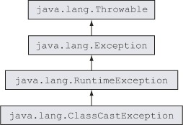
ClassCastException

Slide 13
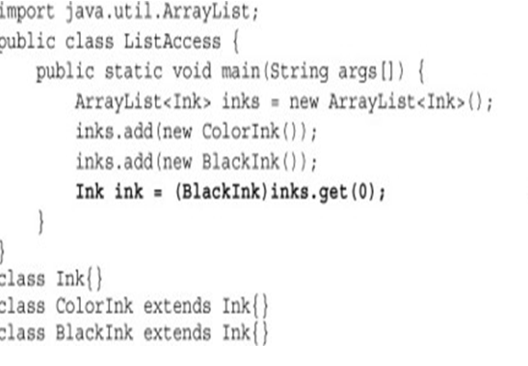
ClassCastException
ClassCastException is thrown when an object fails an IS-A test with the class type to which it’s being cast
Output:
ClassCastException

Slide 14
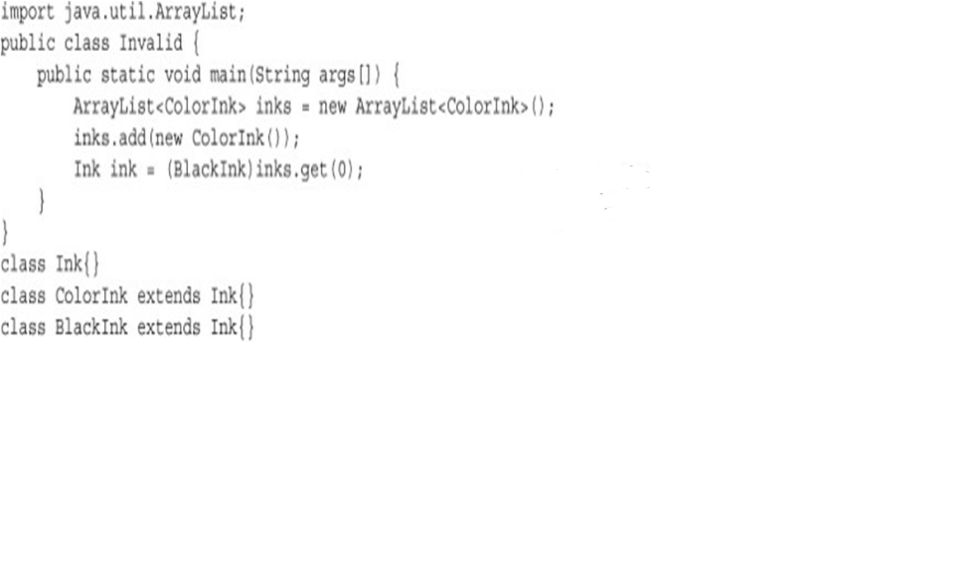
ClassCastException
What will happen now ?
Compilation Error:
Incompatible Types

Slide 15
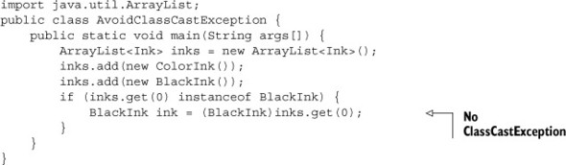
ClassCastException
How to avoid this ?
We can use the instanceof operator to verify whether an object can be cast to another class before casting it

Slide 16
What Is The Output ?
class Ink{}
interface Printable {}
class ColorInk extends Ink implements Printable {}
class BlackInk extends Ink{}
class TwistInTaleCasting {
public static void main(String args[]) {
Printable printable = null;
BlackInk blackInk = new BlackInk();
printable = (Printable)blackInk;
}
}
A. printable = (Printable)blackInk will throw compilation error.
B. printable = (Printable)blackInk will throw runtime exception.
C. printable = (Printable)blackInk will throw checked exception.
D. The following line of code will fail to compile:
printable = blackInk;
Answer:
printable = (Printable)blackInk will throw runtime exception.

Slide 17
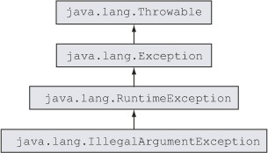
IllegalArgumentException

Slide 18
IllegalArgumentException
As the name of this exception suggests, IllegalArgumentException is thrown to specify that a method has passed illegal or inappropriate arguments.
For example:
Thread th=new Thread();
th.setPriority(11);
The statement will throw IllegalArgumentException because value passed to setPriority( ) method cannot be more than 10

Slide 19
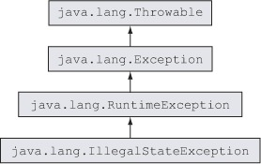
IllegalStateException

Slide 20
IllegalStateException
An IllegalStateException signals that a method has been invoked at an illegal or inappropriate time.
In other words, the Java environment or Java application is not in an appropriate state for the requested operation

Slide 21
IllegalStateException
For example:
Iterator it = vect1.iterator();
while(it.hasNext())
{
it.remove();
}
The above code works fine. But calling it.remove()
without calling it.next() is an IllegalStateException.

Slide 22
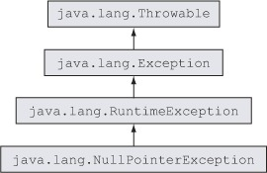
NullPointerException

Slide 23
NullPointerException
This exception is thrown by the JVM if you try to access a method or a variable with a null value.
The only way to avoid this exception is to ensure that the reference variable has been assigned a non-null value

Slide 24
Causes Of NullPointerException
Accessing members of a reference variable that is assigned a null value.
Accessing members of an uninitialized instance or static reference variable. These are implicitly assigned a null value.
Attempting to access positions of a nonexistent array.
Using members of an array element that are assigned a null value.

Slide 25
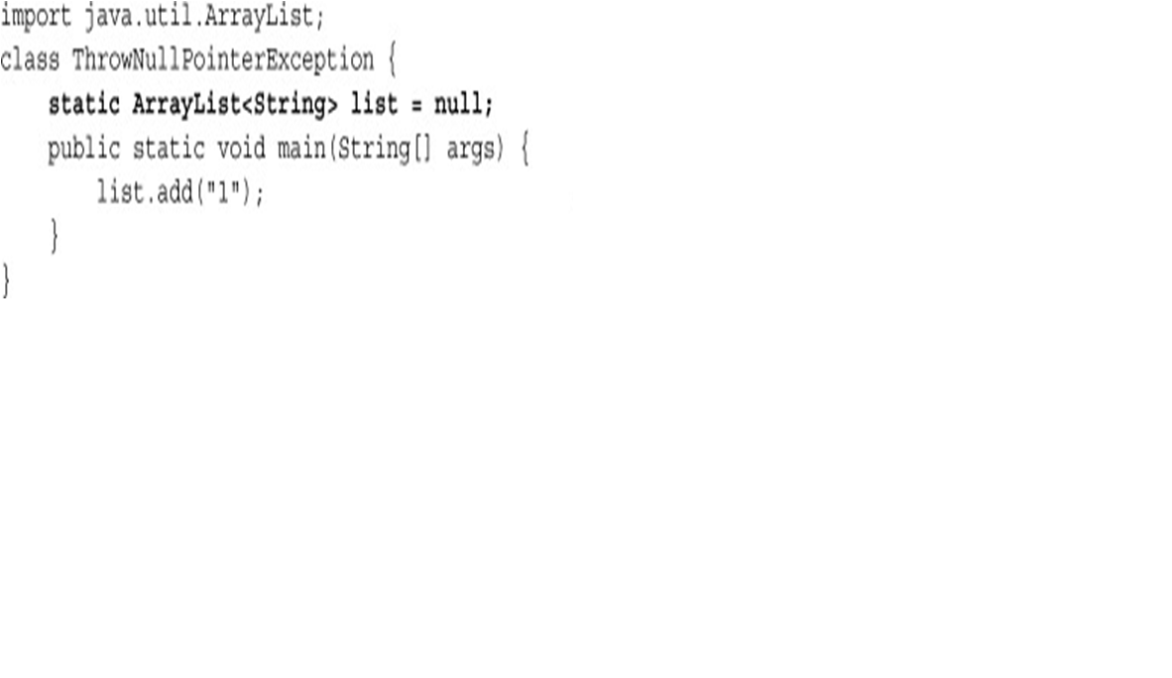
NullPointerException Example
The code below tries to access the method add on variable list, which has been assigned a null value. So it throws a “NullPointerException”
Will throw NullPointerException

Slide 26
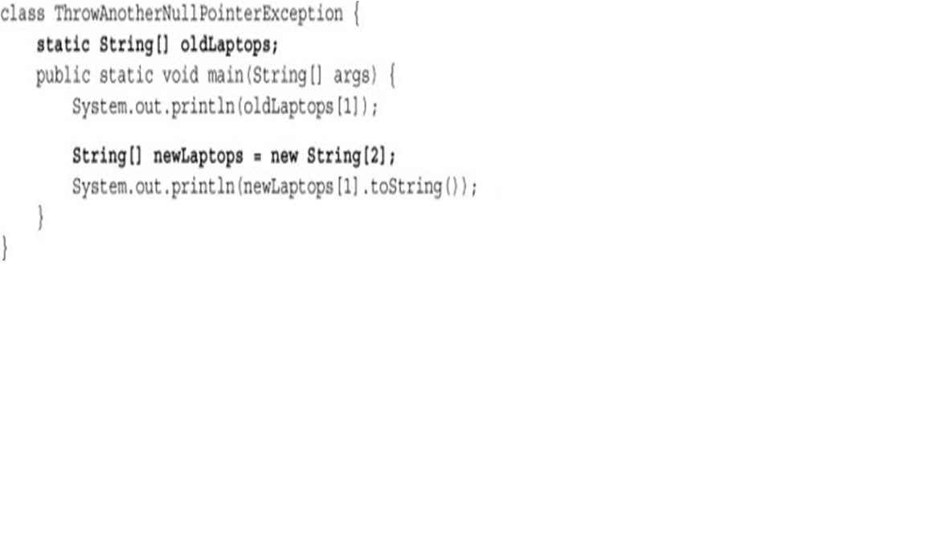
NullPointerException Example
Another set of conditions when code may throw the NullPointerException involves use of arrays:
Will throw NullPointerException
Will throw NullPointerException

Slide 27
What will happen if we remove toString( ) from last SOP ?
String [ ] newLapotops=new String[2];
System.out.println(newLaptops[1]);
it won’t throw an exception—
it’ll print the value null

Slide 28
What Is The Output ?
class Demo{
public static void main(String[] args) {
String[ ][ ] oldLaptops = { {"Dell", "Toshiba", "Vaio"}, null, {"IBM"}, new String[10] }; System.out.println(oldLaptops[0][0]); // line 1 System.out.println(oldLaptops[1]); // line 2 System.out.println(oldLaptops[3][6]); // line 3 System.out.println(oldLaptops[3][0].length()); // line 4 System.out.println(oldLaptops); // line 5
}
}
Code on line 1 will throw NullPointerException
Code on lines 1 and 3 will throw NullPointerException
Only code on line 4 will throw NullPointerException
Code on lines 3 and 5 will throw NullPointerException
Answer:
Only code on line 4 will throw NullPointerException

Slide 29
What Has Java 14 Improved In This ?
Java 14 enhances NullPointerException by showing precisely which variable was null.
Prior to Java 14 NPE messages did not contain the variable nor the method call that occurs the exception.
This behaviour has been corrected, although it needs some small customizations.

Slide 30
What Has Java 14 Improved In This ?
This feature can be enabled with the new boolean command-line option: -XX:+ShowCodeDetailsInExceptionMessages

Slide 31
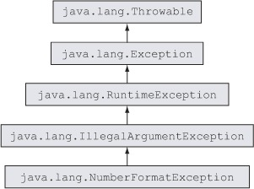
NumberFormatException

Slide 32
NumberFormatException
NumberFormatException is a runtime exception.
It’s thrown to indicate that the application has tried to convert a string (with an inappropriate format) to one of the numeric types.

Slide 33
NumberFormatException
Multiple classes in the Java API define parsing methods.
One of the most frequently used methods is parseInt from the class Integer.
It’s used to parse a String argument as a signed (negative or positive) decimal integer.

Slide 34

NumberFormatException Examples

Slide 35
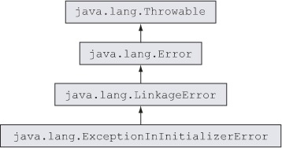
ExceptionInInitializerError

Slide 36
ExceptionInInitializerError
The ExceptionInInitializerError error is typically thrown by the JVM when a static initializer in your code throws any type of RuntimeException.
class Demo {
static{
int n=Integer.parseInt("a");
}
}

Slide 37
ExceptionInInitializerError
The ExceptionInInitializerError error can also be thrown during initialization of a static variable
class Demo {
static{
static String name = null;
static int nameLength = name.length();
}
}

Slide 38
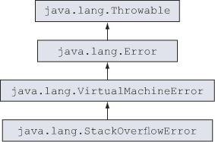
StackOverflowError

Slide 39
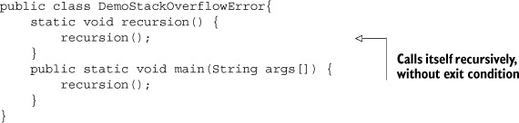
StackOverflowError
This error is thrown by the JVM when a Java program calls itself so many times that the memory stack allocated to execute the Java program “overflows.”

Slide 40
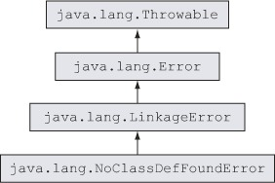
NoClassDefFoundError

Slide 41
NoClassDefFoundError
This error is thrown when the Java Virtual Machine (JVM) tries to load the definition of a class, but the definition could not be found.
The definition of a class can be requested during a method call, or while creating a new instance using a new keyword.

Slide 42
NoClassDefFoundError V/s ClassNotFoundException
NoClassDefFoundError | ClassNotFoundException
It is an unchecked exception | It is a checked exception
It occurs when a hardcoded class is not found at run time | It occurs when a dynamically supplied class is not found at runtime

Slide 43
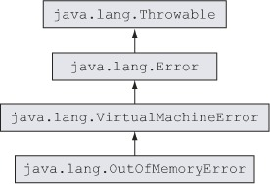
OutOfMemoryError

Slide 44
OutOfMemoryError
To understand OutOfMemoryError we will first have to recall the jvm memory structure.
There are two memory regions in the JVM: the heap and the stack.
Local variables,arguments and running copy of methods reside on the stack, everything else on the heap.

Slide 45

OutOfMemoryError
This Java heap memory itself is structured again into two regions, called generations
Young generation OR Heap
Old Generation OR PermGen

Slide 46
OutOfMemoryError
Heap stores all the objects generated by a running Java program and is automatically freed up by JVM when objects are no longer referenced by the program.
PermGen space is used to keep information for loaded classes , static instances and few other advanced features like String Pool

Slide 47
OutOfMemoryError
The size of those regions is set during the Java Virtual Machine (JVM) launch and can be customized by specifying JVM parameters -Xmx and -XX:MaxPermSize.
For example to set heap size to 128MB we can write the command as :
java -Xmx128m Test
If we do not explicitly set the sizes, platform-specific defaults will be used which is generally 64MB to 1024MB.

Slide 48
OutOfMemoryError
The java.lang.OutOfMemoryError: Java heap space error will be triggered when the application attempts to add more data into the heap space area, but there is not enough room for it.

Slide 49
Popular Interview Questions
1 Select the correct option(s):
A. You cannot handle runtime exceptions.
B. You should not handle Error.
C. If a method throws a checked exception, it must be either handled by the method or specified in it’s throws clause.
D. If a method throws a runtime exception, it may include the exception in its throws clause.
E. Runtime exceptions are checked exceptions.
Answer: B,C,D

Slide 50
Popular Interview Questions
2 Select the incorrect statement(s):
A. java.lang.Throwable is the base class of all type of exceptions.
B. If a class is a subclass of java.lang.Exception, it may or may not be a checked exception.
C. Error is a checked exception.
D. Error and checked exceptions need not be part of a method signature.
Answer: C,D

Slide 51
Popular Interview Questions
3.Given
class Course {
String courseName;
Course() {
Course c = new Course();
c.courseName = "Oracle";
}
}
class Demo {
public static void main(String args[]) {
Course c = new Course();
c.courseName = "Java";
System.out.println(c.courseName);
}
}

Slide 52
Popular Interview Questions
A. The code will print Java.
B. The code will print Oracle.
C. The code will not compile.
D. The code will throw an exception at runtime.
Answer: D

Slide 53
Popular Interview Questions
4. Select the correct option
class Demo{
public static void main(String args[]) {
Demo var = new Demo();
var.printArrValues(args);
}
void printArrValues(String[] arr) {
try {
System.out.println(arr[0] + ":" + arr[1]);
}
catch (NullPointerException e) { System.out.println("NullPointerException"); }
catch (IndexOutOfBoundsException e) { System.out.println("IndexOutOfBoundsException"); }
catch (ArrayIndexOutOfBoundsException e) { System.out.println("ArrayIndexOutOfBoundsException"); } } }

Slide 54
Popular Interview Questions
A. If the class Demo is executed using the following command, it prints NullPointerException: java Demo
B. If the class Demo is executed using the following command, it prints IndexOutOfBoundsException: java Demo
C. If the class Demo is executed using the following command, it prints ArrayIndexOutOfBoundsException: java Demo
D. The code will fail to compile.
Answer: D

Slide 55
Popular Interview Questions
5. Select the correct option
class Demo {
void method() {
try {
guru();
return;
}
finally {
System.out.println("finally 1");
}
}
void guru() {
System.out.println("guru");
throw new StackOverflowError();
}
public static void main(String args[]) { Demo var = new Demo(); var.method(); } }

Slide 56
Popular Interview Questions
A. guru finally 1
B. guru finally 1 Exception in thread "main" java.lang.StackOverflowError
C.guru Exception in thread "main" java.lang.StackOverflowError
D. guru
E. The code fails to compile.
Answer: B

Slide 57
Popular Interview Questions
6. Select the incorrect statement(s):
A. Exceptions enable a developer to define the programming logic separate from the exception-handling code.
B. Exception handling speeds up execution of the code.
C. Exception handing is used to define code that should execute when a piece of code throws an exception.
D. Code that handles all the checked exceptions can still throw unchecked exceptions.
Answer: B

Slide 58
Popular Interview Questions
7. Given
class TryFinally {
int tryAgain() {
int a = 10;
try {
++a;
}
finally
{
a++;
}
return a;
}
public static void main(String args[])
{ System.out.println(new TryFinally().tryAgain()); } }

Slide 59
Popular Interview Questions
What is the output ?
A.10
B.11
C.12
D.Compilation error
E. Runtime exception
Answer: C

Slide 60
Popular Interview Questions
8. Given
class Base {
void myMethod() throws ExceptionInInitializerError { System.out.println("Base"); }
}
class Derived extends Base {
void myMethod() throws RuntimeException { System.out.println("Derived"); }
}
class Demo { public static void main(String args[]) {
Base obj = new Derived(); obj.myMethod();
}
}

Slide 61
Popular Interview Questions
What is the output ?
A. Base
B. Derived
C. Derived Base
D. Base Derived
E. Compilation error
Answer: B

Slide 62
Popular Interview Questions
9. Which of the following statements are true?
A. A user-defined class may not throw an IllegalStateException. It must be thrown only by Java API classes.
B. System.out.println will throw NullPointerException if an uninitialized instance variable of type String is passed to it to print its value.
C. NumberFormatException is thrown by multiple methods from the Java API when invalid numbers are passed on as Strings to be converted to the specified number format.
D. ExceptionInInitializerError may be thrown by the JVM when a static initializer in your code throws a NullPointerException.
Answer: C & D

Slide 63
Popular Interview Questions
10. Given:
Which could be used to create an appropriate catch block? (Choose all that apply.)
A. ClassCastException
B. IllegalStateException
C. NumberFormatException
D. IllegalArgumentException
E. ExceptionInInitializerError
F. ArrayIndexOutOfBoundsException
Answer: C & D

Slide 64
Java 7 New Enhancements To Exception Handling
Beginning from Java 7 onwards , java has provided us 2 new enhancements to exception handling code.
They are:
Multiple exception types in a single catch block.
Try-with-resources statements

Slide 65
Try With Multi-Catch
Sometimes we want to handle different types of exceptions the same way.
But we don’t want to repeat the code.
To understand this consider designing a code that reads a string representing a date written in a file and then converts it to proper Date object.
How would you write the code ?

Slide 66
Try With Multi-Catch
import java.io.*;
import java.text.*;
import java.util.*;
public class Example {
public static void main( String[] args ) {
try {
BufferedReader br = new BufferedReader(new FileReader(“data.txt”))
String line = br.readLine();
SimpleDateFormat sdf= new
SimpleDateFormat(“MM/DD/YY”);

Slide 67
Try With Multi-Catch
Date date = sdf.parse(line);
}
catch(ParseException ex1)
{
System.out.println(“Exception:”+ex1);
}
catch(IOException ex2)
{
System.out.println(“Exception:”+ex2);
}
}

Slide 68
Try With Multi-Catch
We can observe that the two catch blocks have same code mentioned in them.
In order to facilitate the programmer’s work, Java SE 7 now includes a multi-catch statement.
This allows the programmer to combine multiple catch clauses into a single block of code without the need to repeat the code.

Slide 69
Syntax
This is bitwise OR operator
catch(ExceptionType | ExceptionType . . . variable)
{
// handle our problems here.
}

Slide 70
Improved Version
import java.io.*;
import java.text.*;
import java.util.*;
public class Example {
public static void main( String[] args ) {
try {
BufferedReader br = new BufferedReader(new FileReader(“data.txt”))
String line = br.readLine();
SimpleDateFormat sdf= new
SimpleDateFormat(“MM/DD/YY”);

Slide 71
Improved Version
Date date = sdf.parse(line);
}
catch(ParseException | IOException ex)
{
System.out.println(“Exception:”+ex);
}
}
}

Slide 72
Points To Remember With Multi-Catch
With multi-catch, order doesn’t matter.
The following two snippets are equivalent to each other:
catch(SQLException | IOException ex)
catch(IOException | SQLException ex)

Slide 73
Points To Remember With Multi-Catch
But in multi-catch, we have to make sure a given exception can only match one type.
The following will not compile:
catch(IOException | FileNotFoundException ex)
catch(FileNotFoundException | IOException ex)
We’ll get a compiler error that looks something like:
The exception FileNotFoundException is already caught by the alternative IOException
Both are wrong!

Slide 74
Points To Remember With Multi-Catch
Since FileNotFoundException is a subclass of IOException, we could have just handled IOException
There was no need to use multi-catch. The simplified and working version simply says:
catch(IOException ex)
Remember, multi-catch is only for exceptions in different inheritance hierarchies.
This is correct!

Slide 75
Points To Remember With Multi-Catch
Don’t assign a new value to the multi-catch parameter.
Although the following code is legal with single catch parameter:
try
{
}
catch(IOException ex)
{
ex=new IOException( );
}
But it won’t work with multi-catch
This is correct!

Slide 76
Points To Remember With Multi-Catch
This is wrong!
try
{
}
catch(SQLException | IOException ex)
{
ex=new IOException( );
}
Since multi-catch uses multiple types, there isn’t a clearly defined type for the variable that we can set.
Moreover Java internally makes the catch parameter final. And when that happens the code doesn’t compile because we can’t assign to a final variable.

Slide 77
Try With Resources
In our BufferedReader example there is a problem!
Can you figure it out ?
The problem is that there is no cleanup of the resources being used inside the try block.
That is we are not closing the file opened in try block
Example 7 is an updated version that describes how, prior to Java SE 7, a programmer would address this problem.

Slide 78
Try With Resources
In our BufferedReader example there is a problem!
Can you figure it out ?
The problem is that there is no cleanup of the resources being used inside the try block.
In simple words , we are not closing the file opened in try block

Slide 79
Try With Resources
Prior to Java 7 , the only solution to the problem is to use finally block.
But it will require a lot many changes to be made:
Declaring the BufferedReader variable outside try
Initializing it with null
Creating a finally block
Checking whether file was opened or not
If it is opened , then writing a try-catch again
Then inside try calling the close( ) method.

Slide 80
Try With Multi-Catch
import java.io.*;
import java.text.*;
import java.util.*;
public class Example {
public static void main( String[] args ) {
BufferedReader br=null;
try {
br = new BufferedReader(new FileReader(“data.txt”))
String line = br.readLine();
SimpleDateFormat sdf= new
SimpleDateFormat(“MM/DD/YY”);

Slide 81
Try With Multi-Catch
Date date = sdf.parse(line);
}
catch(ParseException ex1)
{
System.out.println(“Exception:”+ex1);
}
catch(IOException ex2)
{
System.out.println(“Exception:”+ex2);
}

Slide 82
Try With Multi-Catch
finally
{
if(br!=null)
{
try
{
br.close();
}
catch(IOException e)
{
e.printStackTrace();
}
}
}
}
}

Slide 83
A Much Better Solution-try with resources
A much better and elegant solution to the previous problem is to use Java 7’s new try with resources statement.
The try-with-resources statement is a try statement that declares one or more resources.
A resource is an object that must be closed after the program is finished with it.
The try-with-resources statement ensures that each resource is closed at the end of the statement.

Slide 84
A Much Better Solution-try with resources
import java.io.*;
import java.text.*;
import java.util.*;
public class Example {
public static void main( String[] args ) {
try(BufferedReader br= new BufferedReader(new FileReader(“data.txt”)))
{
String line = br.readLine();
SimpleDateFormat sdf= new
SimpleDateFormat(“MM/DD/YY”);

Slide 85
A Much Better Solution-try with resources
Date date = sdf.parse(line);
}
catch(ParseException | IOException ex)
{
System.out.println(“Exception:”+ex1);
}
}
}
No finally left at all! We don’t even mention closing the
reader.
Automatic Resource Management takes care of it for
us.
Notice that we don’t have to design any finally block

Slide 86
Points To Remember With try with resources
All the classes cannot be used in try-with-resources.
Only those classes that implements AutoCloseable can be used as a resource in try-with-resources, else we will get compilation error.
The following will not compile:
try(String s=“Bhopal”){
}
We’ll get a compiler error that looks something like:
The resource type String does not implement java.lang.AutoCloseable
This is wrong!

Slide 87
Points To Remember With try with resources
AutoCloseable only has one method to implement.
This method is called close( ) which is automatically called
Multiple resources can be declared within the same try as:
try (Lion lion = new Lion();
Tiger tiger = new Tiger()) {…

Slide 88
Points To Remember With try with resources
When multiple resources are used in ‘try, then the close() method is called in the reverse order
try-with-resources, can have catch and finally. They work as usual and no change in it.
In try-with-resources on exception, before going to catch the close() statements will be executed.
Resource is implicitly declared as final.

Slide 89
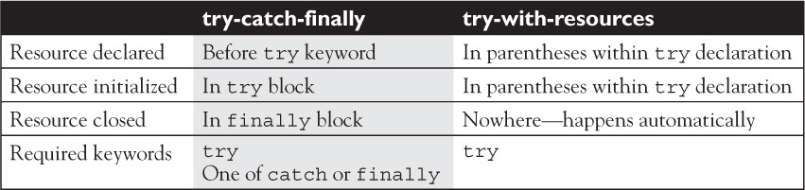
Points To Remember With try with resources

